Slide 1
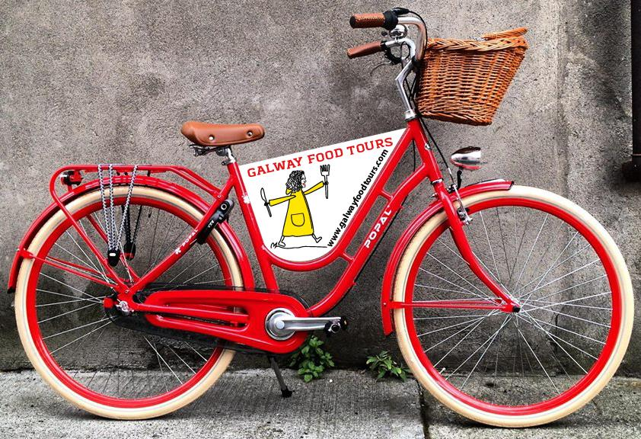
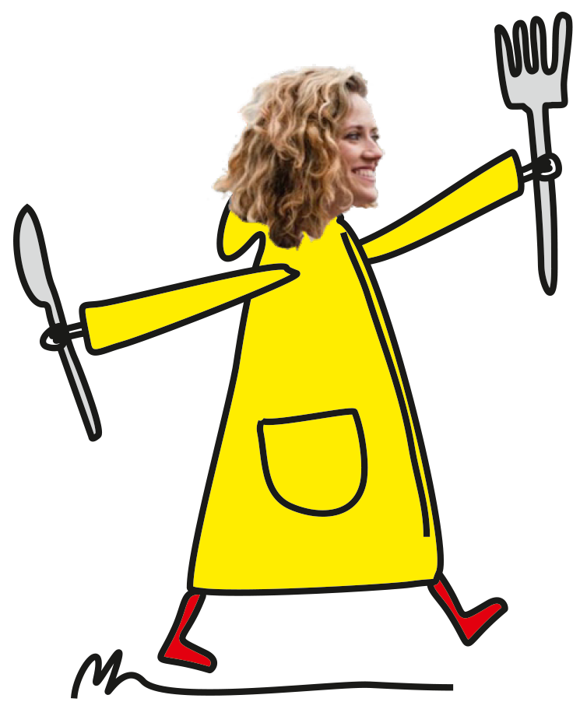
GALWAY FOOD TOURS
Presented by
Sheena Dignam

Slide 2
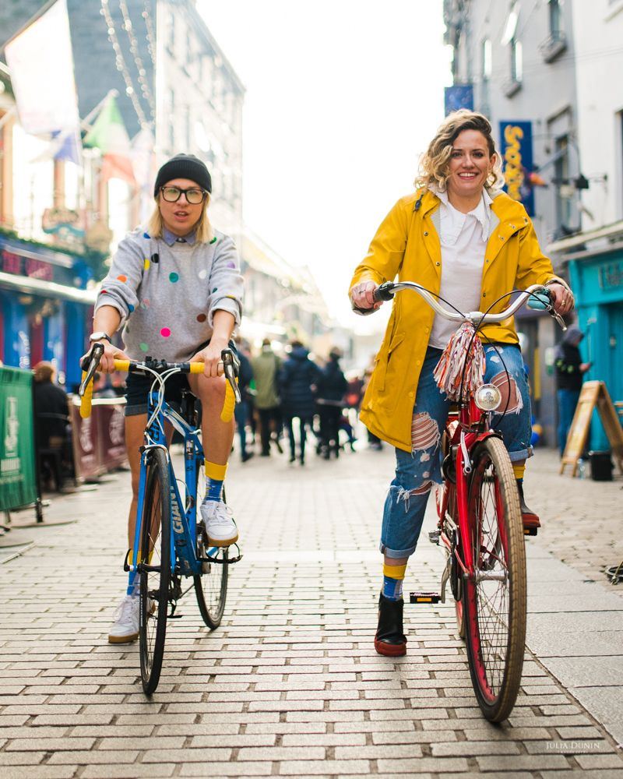
Who We Are?
We are Sheena Dignam & Gosia Letowska, Galway’s most passionate and clued in food lovers.
We have been engrained into the fabric of the Galway City’s exciting culinary scene for many years

Slide 3
Video Link what we do….
https://bit.ly/3viIfiv

Slide 4
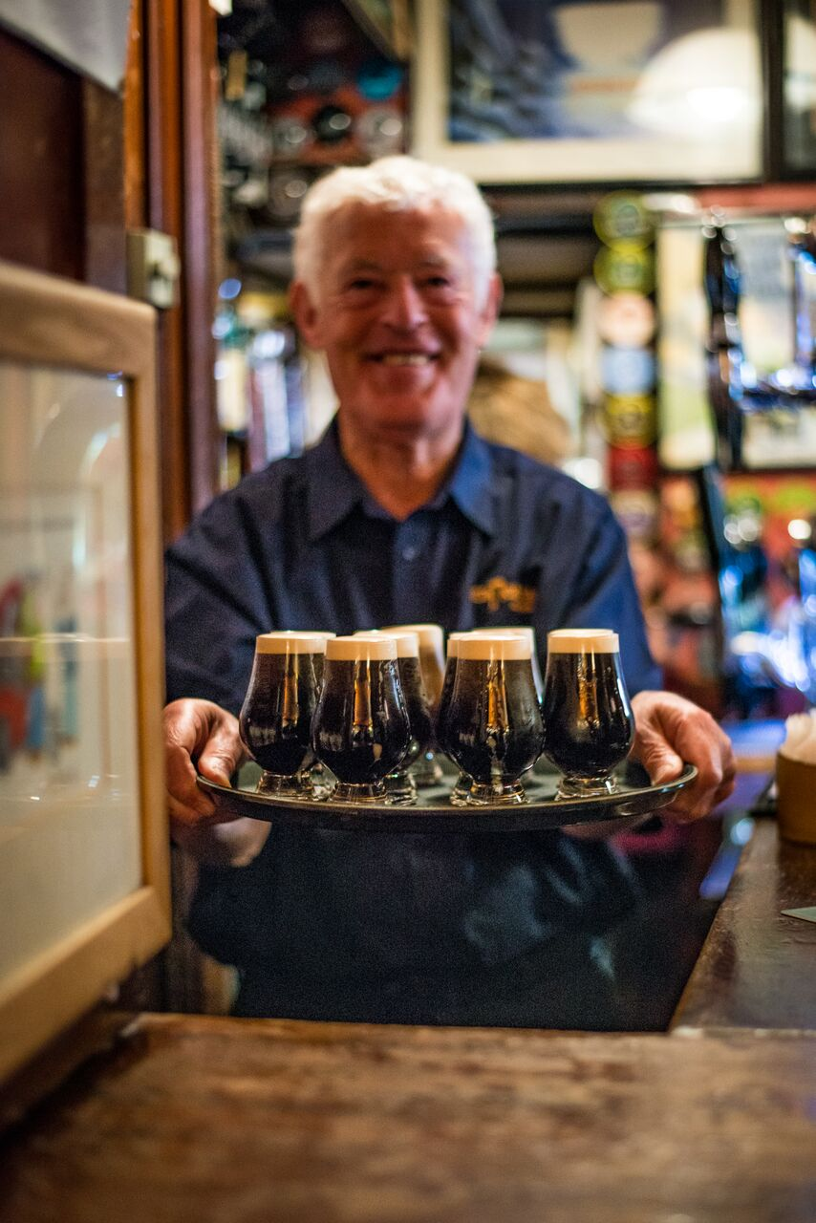
What We Do?
Galway Day Food Tour : 2.5h
Galway Evening Food Tour 3.5h
Whiskey Tour 2.5h
Sweet Tooth Food Tour 2.5h
Galway Hooker Boat Food Tour 4.5h
Ring Carving Food Tour 4.5/5h
Food & Cycle Tour 4.5h
Craft Food Tour 4.5h

Slide 5
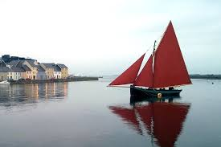
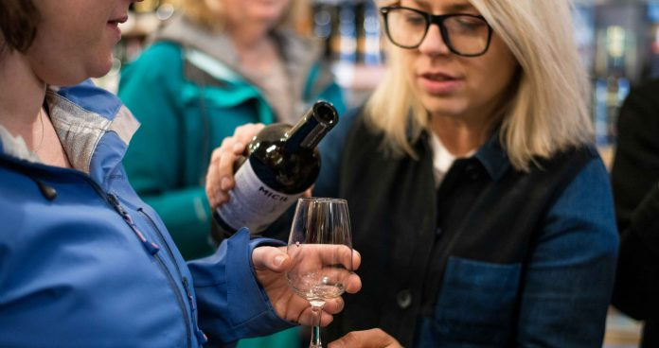
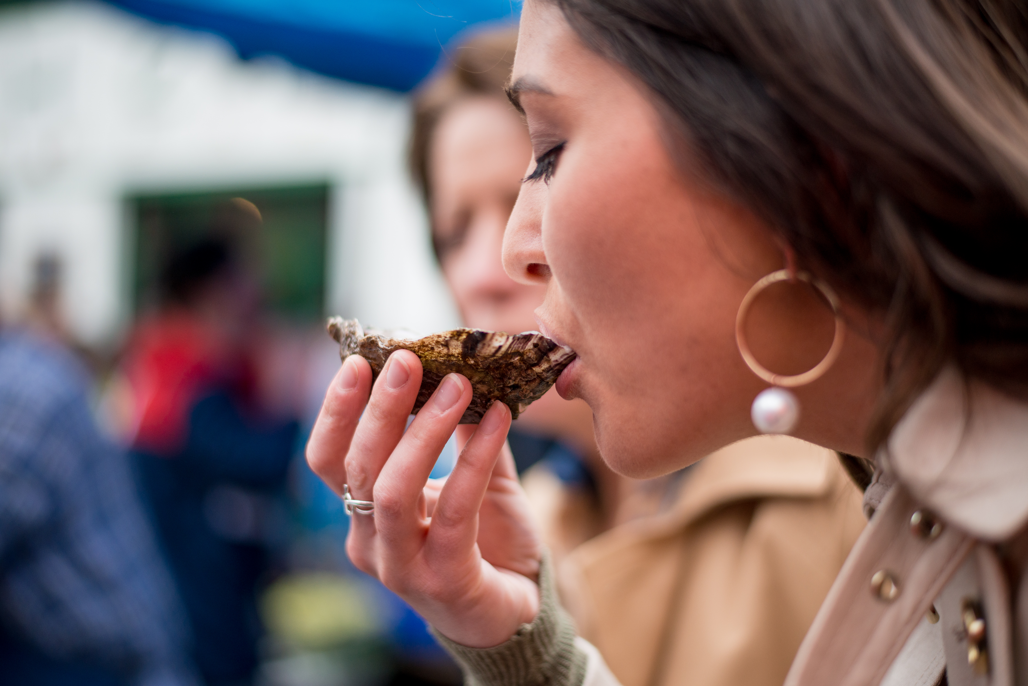
Why Do We Do It?
The Love of Beautiful Galway
The Love of Great Food & Drink

Slide 6
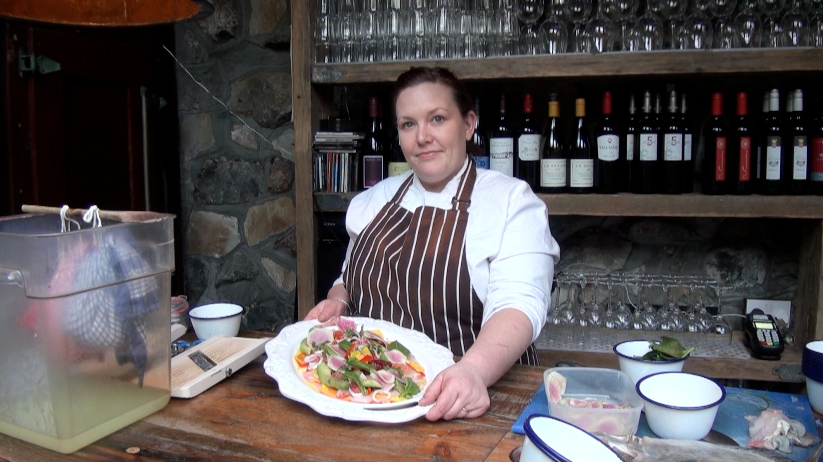
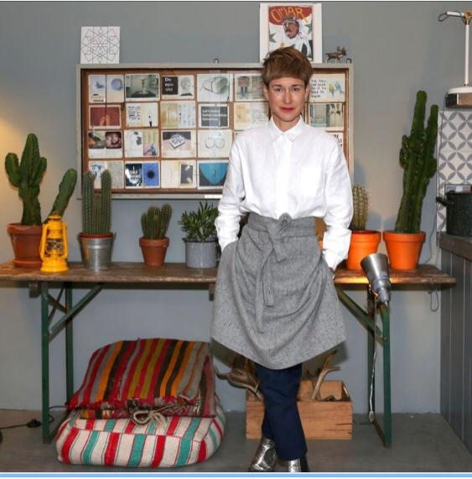
Why Do We Do It?
To Showcase Galway Talent

Slide 7
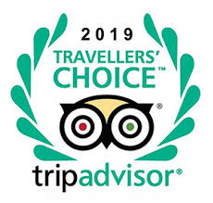

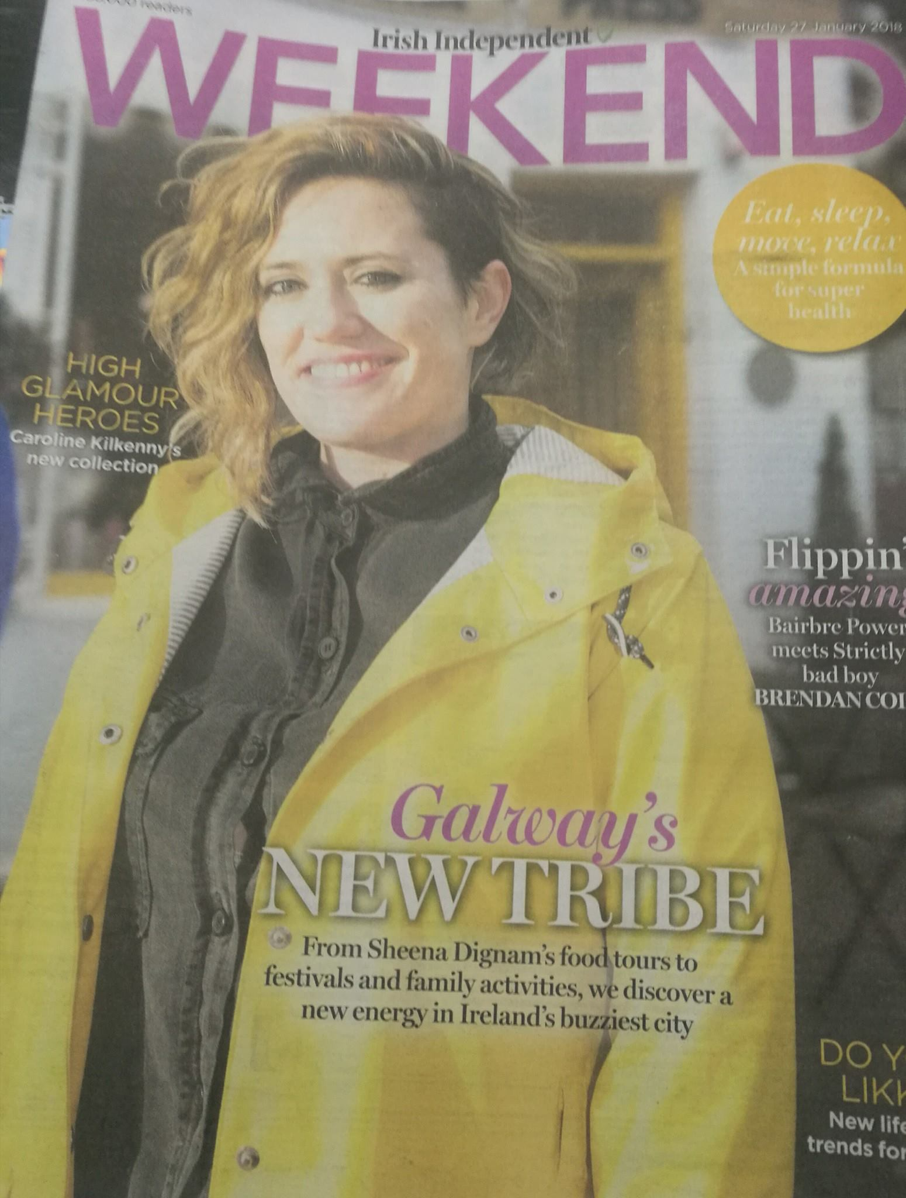
Awards and Accolades
Awards:
Best Food & Beverage Experience in Ireland 2019
Business All Star 2019
Mentions In Publications :
Top 5 Food Experiences in Ireland, National Geographic 2020
Number 1 Top Things to Do in Galway , Pol O'Conghaile Irish Independent 2020

Slide 8

Our Business and Covid-19
Running a reduced occupancy to comply with social distancing – between 4 to 8 people in a group.
Private tours from 2 pax
Staff will be wearing masks at all times.
Staff will use disposable gloves where required
Lead booker must have contact details of each person in that booking. This is in case of contact tracing.
Hand sanitiser will be provided on tour

Slide 9

Our Business and Covid-19
Launch of our self guided pocketbook
Explore Galway like a local in your own time and on your own terms with their new guidebook

Slide 10
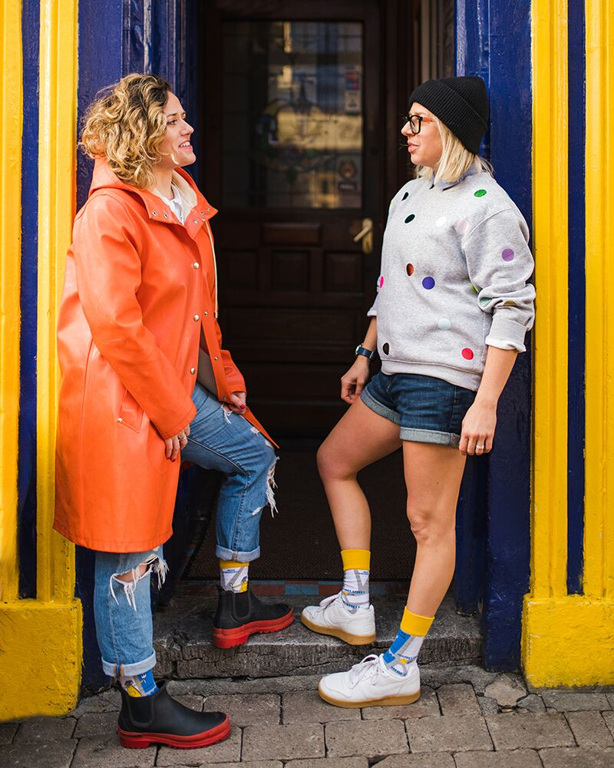
Thank you Hope to see you on a Galway Food Tour Soon !

