Slide 1
Yoga mara: Tailor Made wellness

Slide 2
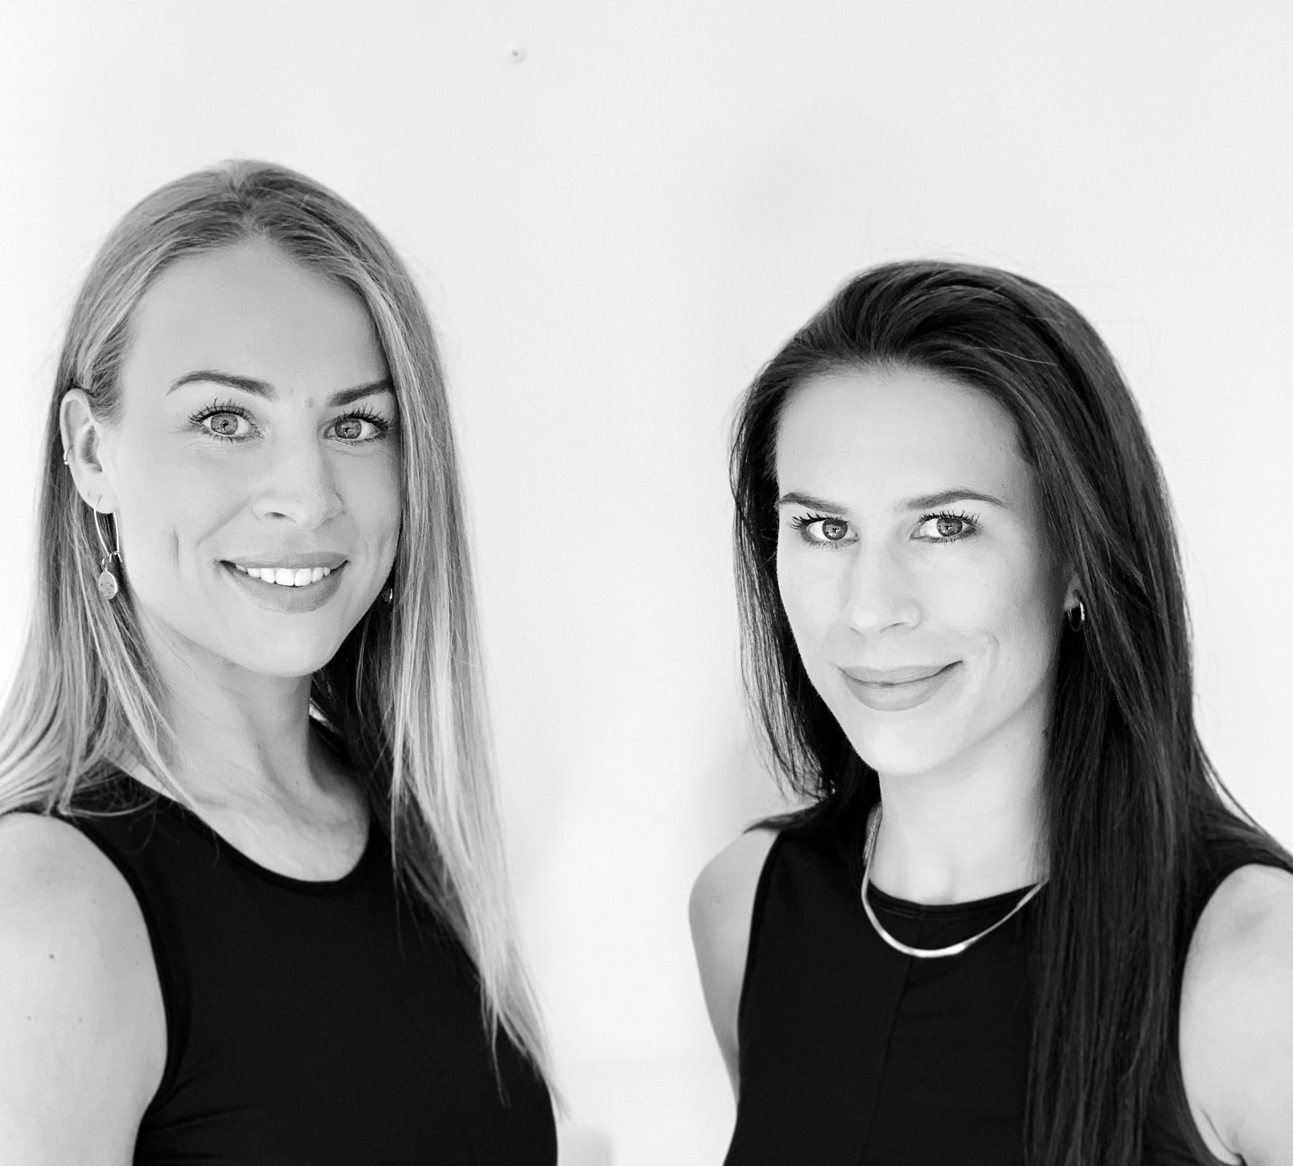
Introducing yoga mara
Yoga Mara Co-Founders:
Galway sisters: Hannah & Rachel Healy
Yoga Mara aims to bring balance and calm back into the hectic lives of their guests through yoga, meditation, nutrition and inspiring conversation.
The Yoga Mara philosophy is simple… take time. Time to relax, refresh and revitalise.
Rachel and Hannah are both qualified yoga instructors whose hands-on approach and attention to detail differentiates Yoga Mara as a genuinely 5* wellness experience unlike any other. Rachel has completed her MBCT/MBSR training in Mindfulness Based Cognitive Therapy while Hannah has recently qualified as a Holistic Massage Therapist. With contrasting personalities, both sisters bring a Yin & Yang energy to every Yoga Mara adventure, making it an unforgettable experience for each guest.

Slide 3
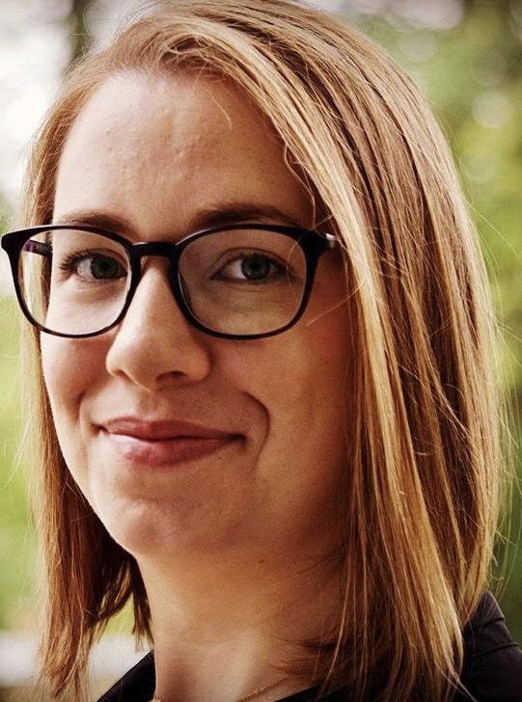
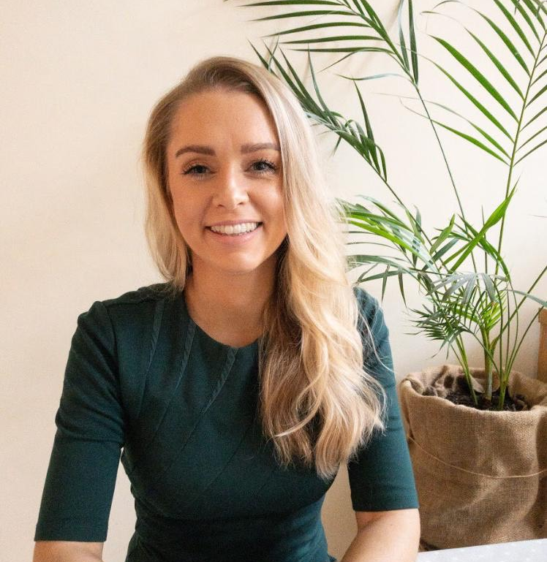
Meet the extended yoga mara team of wellness experts
Marine Biologist, Sustainability Expert
& Published Chef, Finn Ni Fhaolain
Mindful Art Therapist & Mindfulness Coach,
Brigid Nee
Professional Clinical Nutritionist,
Jessica O’ Dwyer.

Slide 4
wellness offerings

Slide 5
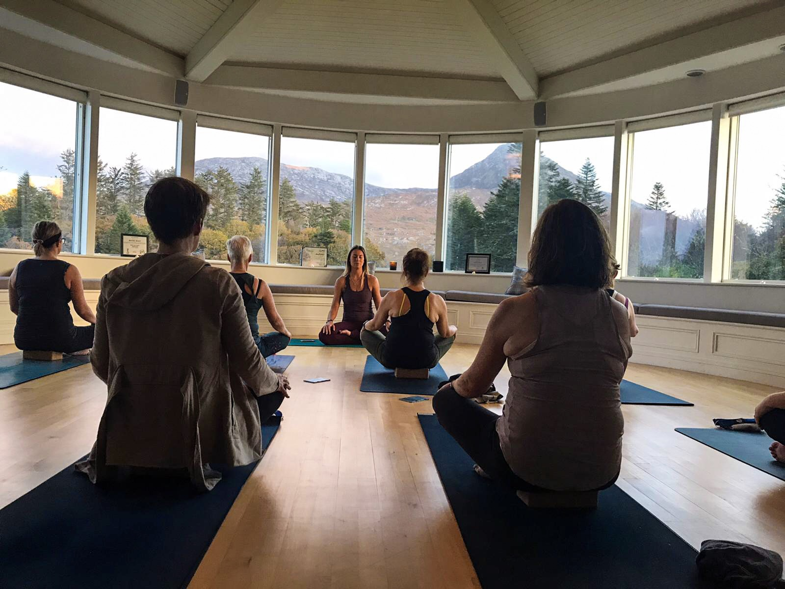
Personalised private yoga class
Detailed Inclusions:
Private 60mins yoga and mindfulness class for group (min 6 pax, max 15 pax) or individual/couples (alternative time possible)
2 x yoga instructors – one to lead the class and the other to offer hands on assist
Exclusive opportunity to help design your specialised yoga practice
All yoga equipment: yoga mats, blocks, straps, bolsters, blankets and face cloths
Essential oils to relax body and mind
Gentle head and neck massage during Savasana
Yoga Mara tote bag including surprise gift
Yoga Mara bring wellness to you- you decide location and venue

Slide 6
Private guided meditation
Detailed Inclusions:
Private 20-30mins guided meditation for group (min 6 pax, max 15 pax) or individuals/couples (alternative duration time possible)
Gentle head massage at the beginning of the meditation using Lavender essential oil
All meditation equipment: yoga mats, bolsters, blankets and face cloths
Yoga room décor: incense, candles, lanterns, diffuser and speaker
Yoga Mara tote bag including surprise gift

Slide 7
All inclusive wellness escape
Detailed Inclusions
Min of 2 x nights bed & breakfast in venue of your choice.
Healthy and substantial dinner each evening (lunch inclusion optional).
2 x yoga classes each day- Vinyasa flow and evening Yin/Restorative/Yoga Nidra.
Guided meditations & welcoming circle.
Exclusive opportunity to design your dream wellness escape with Rachel & Hannah.
Both Rachel & Hannah on site over the entire duration of escape to make sure all needs are met.
2 x yoga instructors for each yoga class.

Slide 8
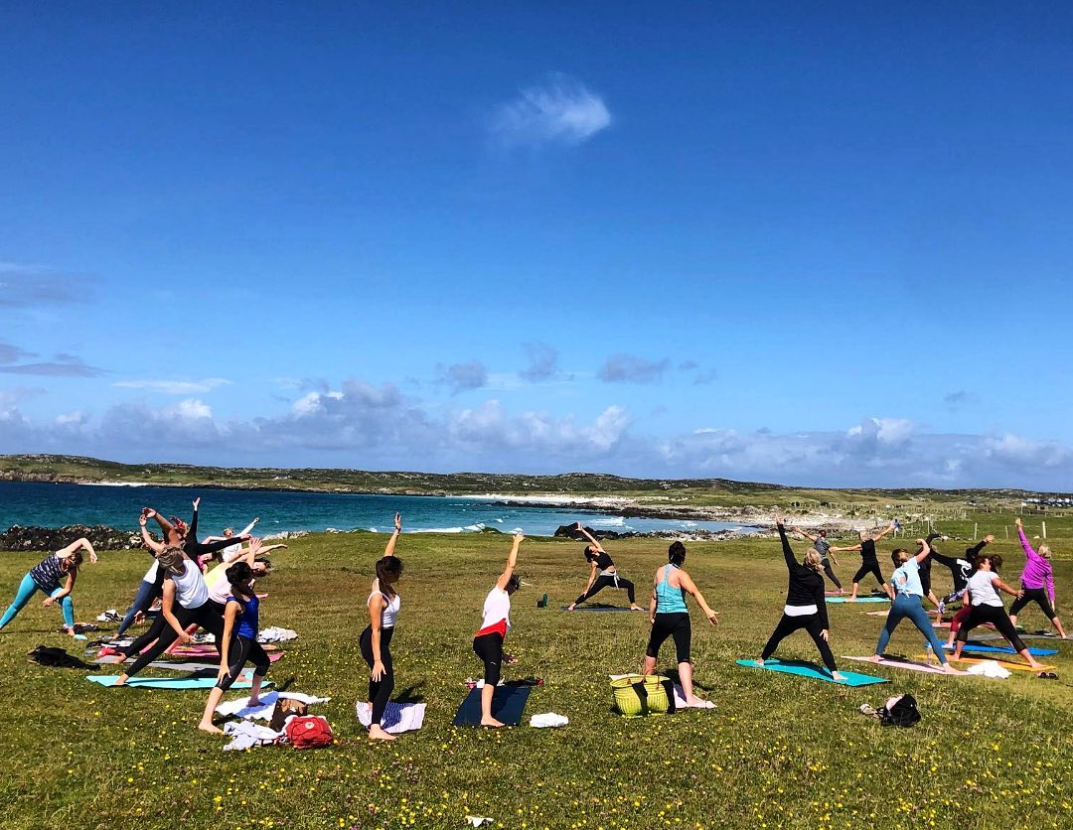
All inclusive wellness escape
Detailed Inclusions
All yoga equipment: yoga mats, blocks, straps, bolsters, blankets and face cloths.
Essential oils to help relax and revitalise the body and mind.
Gentle head and neck massage during Savasana.
Yoga room décor: incense, candles, lanterns, diffuser and speaker.
Yoga Mara tote bag including surprise gift.

Slide 9
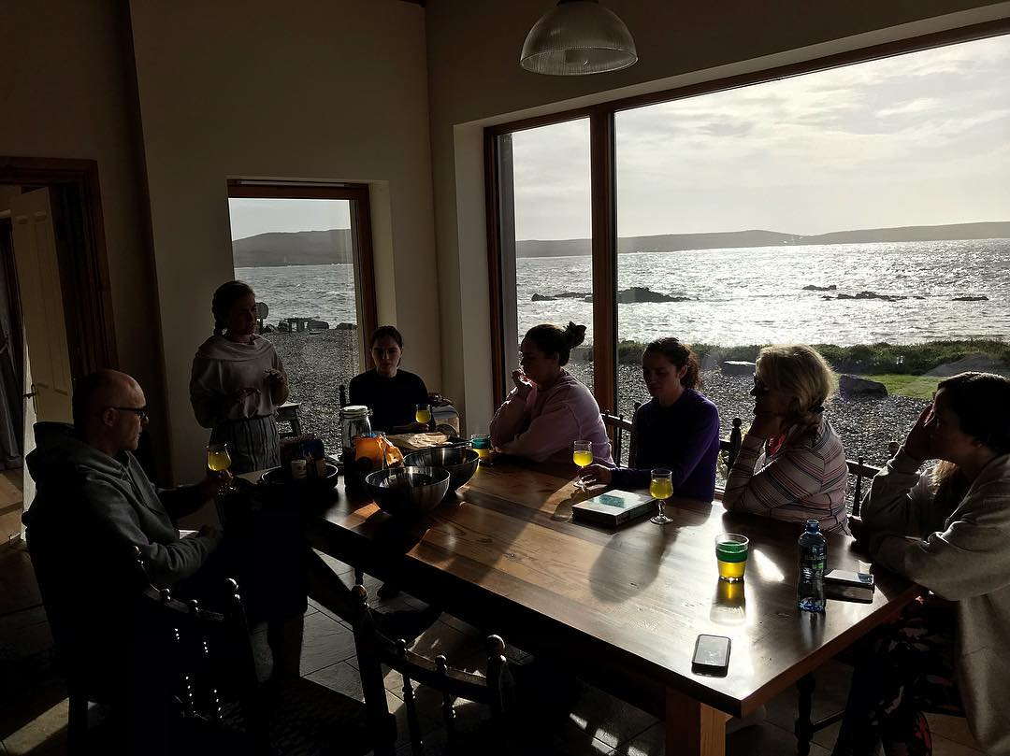
All inclusive wellness escape
Additional Inclusions:
Cooking demonstration with property head chef
Natural Skincare demonstration with sustainable chef and marine biologist, Finn Ni Fhaoilain
Full body holistic massage
Guided meditation class
Yoga workshop – exploring the fundamentals of yoga
Mindfulness Art Therapy workshop
Nutrition workshop
Range of on-site activities available at hotel/property of your choice

Slide 10
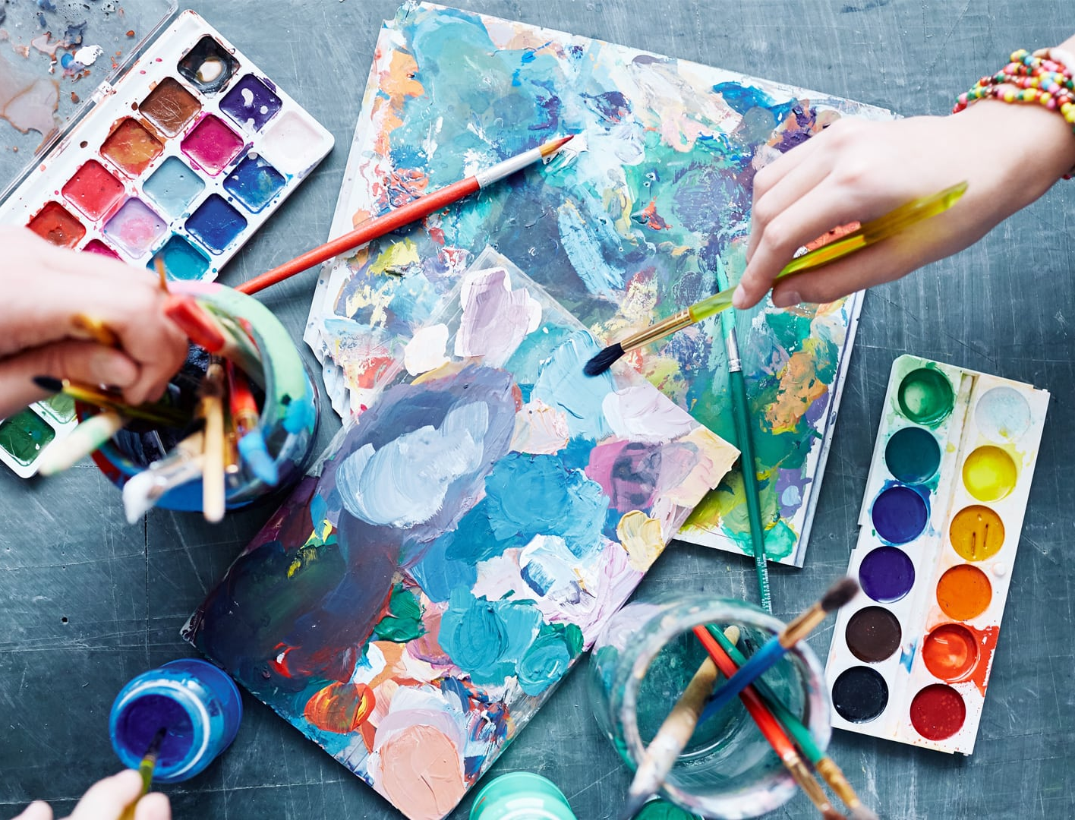
Mindful art therapy with yoga mara
Mindful art therapy
Session with Brigid Nee,
Art Psychotherapist BA (Hons), MA IACAT, IACAP
Brigid has been qualified as an Art Psychotherapist for 6 years and is currently training as a Mindfulness Teacher.
Through mindful art workshops participants are being gently introduced to this process of communicating through art making, whilst sparking joy at their creative capabilities. This workshop is suitable for anyone, no previous experience of art making is required. The end goal is not to create a beautiful work of art but to explore oneself through the process of creating.

Slide 11
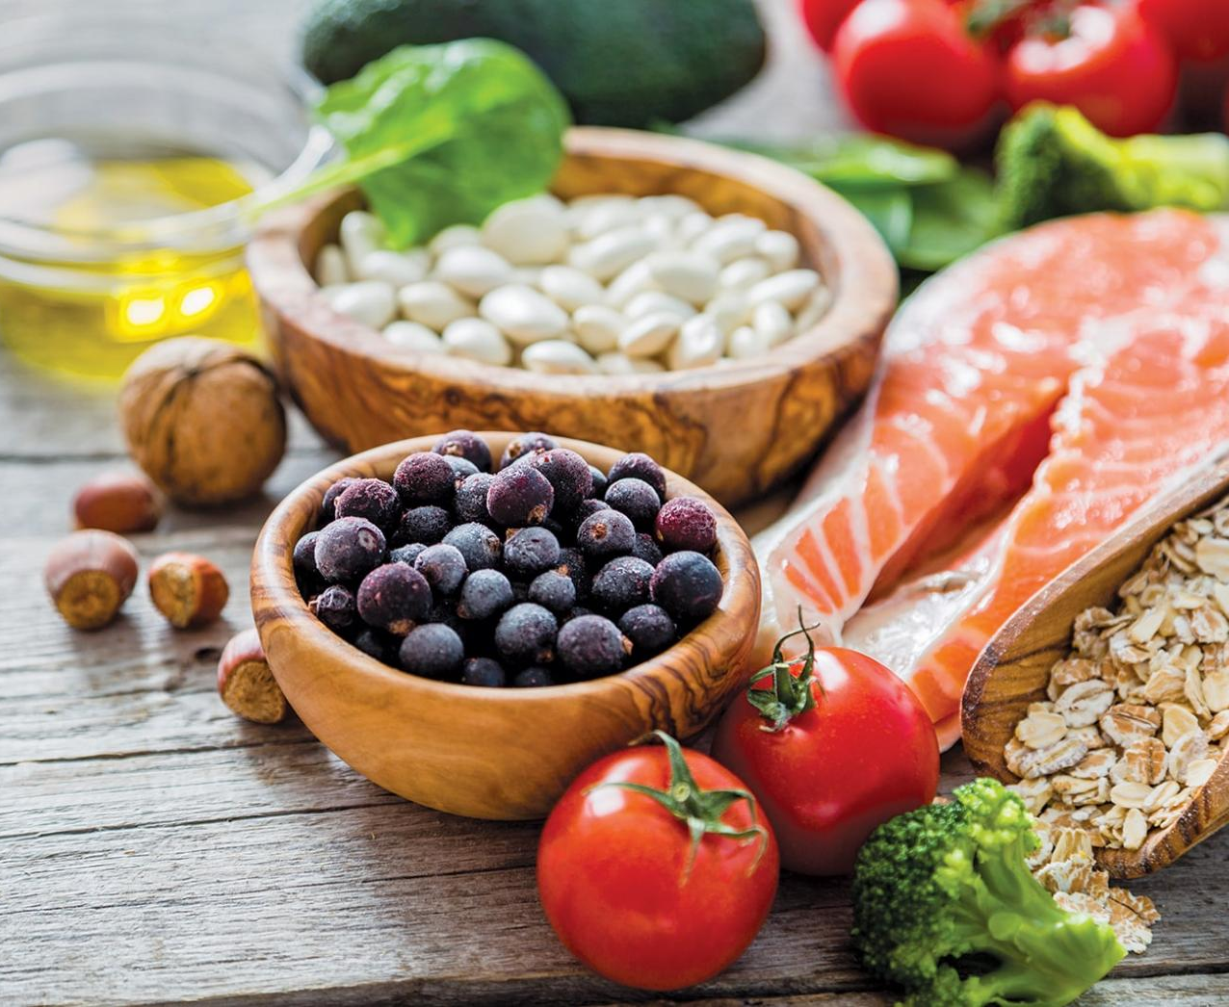
Nutritional wellness with yoga mara
The Nutrition Guide:
Session with Professional Clinical Nutritionist,
Jessica O’ Dwyer.
Jessica, originally from Galway, has been living in London for the last few years practicing as a Clinical Educator at Genova Diagnostics and a Clinical Nutritionist at The London Clinic of Nutrition.
Jessica has a wealth of knowledge, experience and expertise in so many areas, including; gut health, hormonal imbalance, nutrition and preventative medicine.

Slide 12
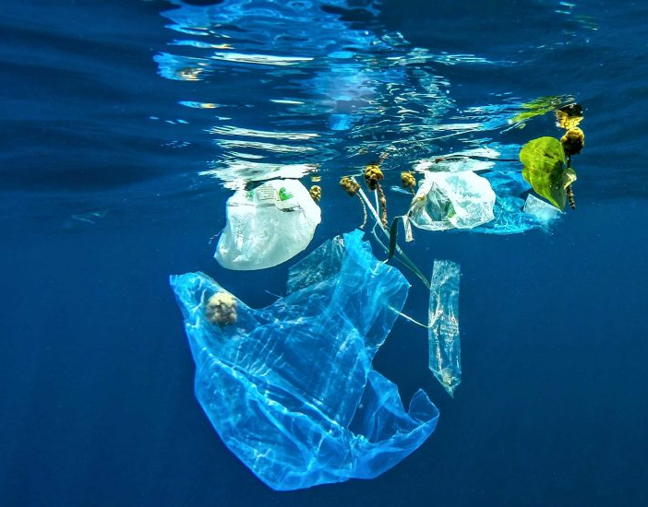
Sustainability with yoga mara
Reducing plastic & intro to zero waste
With a background in marine biology & ocean science Finn shares her first-hand experience of dealing with plastics in our oceans & give tips and advice on how to greatly reduce plastic use & food waste
Natural Skincare
Tips & tricks on incorporating natural skincare into your daily routine plus lots of simple recipes & swaps you can make yourself

Slide 13
Yoga mara virtual wellness
Virtual wellness offerings:
Webinar based experiences:
- The Brain Break
- Open Body, Open Mind
Live yoga flow
Live chair yoga
Live guided meditation
Mindful art therapy session
Nutrition workshop

Slide 14
Yoga mara: Alternative wellness

Slide 15
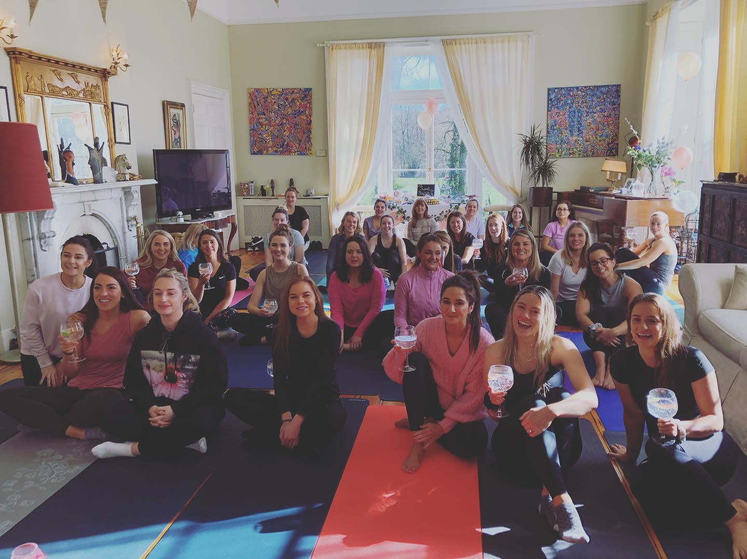
The zen hen with yoga mara
We at Yoga Mara believe that life is all about balance.
Who’s to say you can’t follow an invigorating yoga class with a prosecco fuelled game of Mr. and Mrs? Not us!
Join the Zen Hen movement and help restore balance (literally and figuratively) back into stressed brides and bridesmaids everywhere!
We’ll have you and your Hens yoga’ing to the chessiest, girliest playlist with lots of laughter, craic and wedding night prep stretching guaranteed!

Slide 16
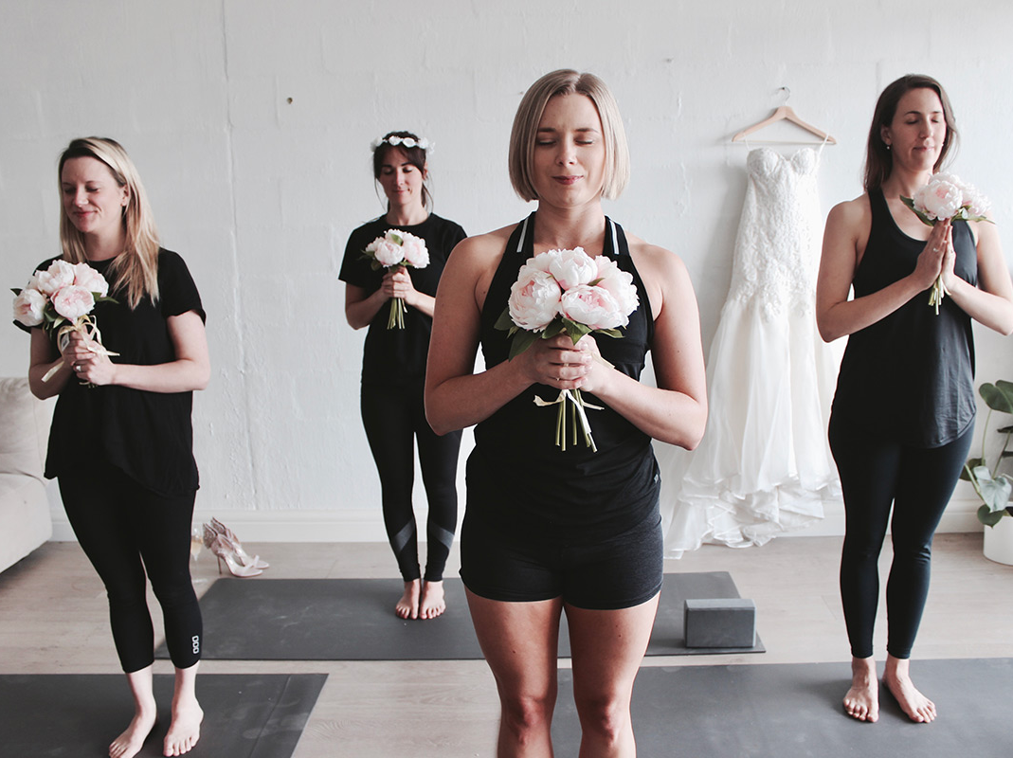
Wedding wellness with yoga mara
Bridal Party Yoga Class:
with 2 x qualified yoga instructors
The Night Before:
A gentle flow yoga class followed by head massage using doTERRA Essential Oils & Yoga Nidra for the bride and bridal party to calm any pre-wedding nerves and promote a blissful sleep.
The Morning Of:
Invigorating yoga flow class for the Bridal Party on the morning of the big day!
Day 2 Yoga for wedding guests:
with 2 x qualified yoga instructors
Begin the day with the new Mr. & Mrs. with a detoxifying and rejuvenating yoga class.

Slide 17
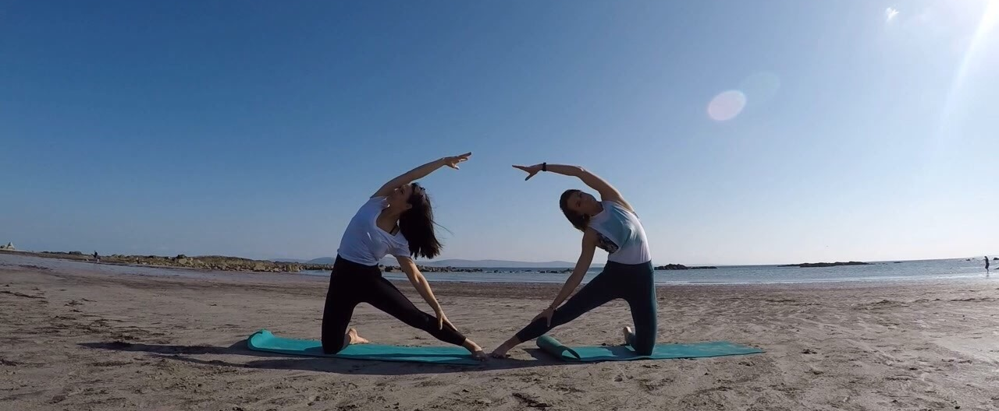
Contact us:
Contact: Hannah Healy
Email: yogamaraescapes@gmail.com
Phone: +353 85 204 2364
Website: www.yogamaraescapes.com

